Slide 1
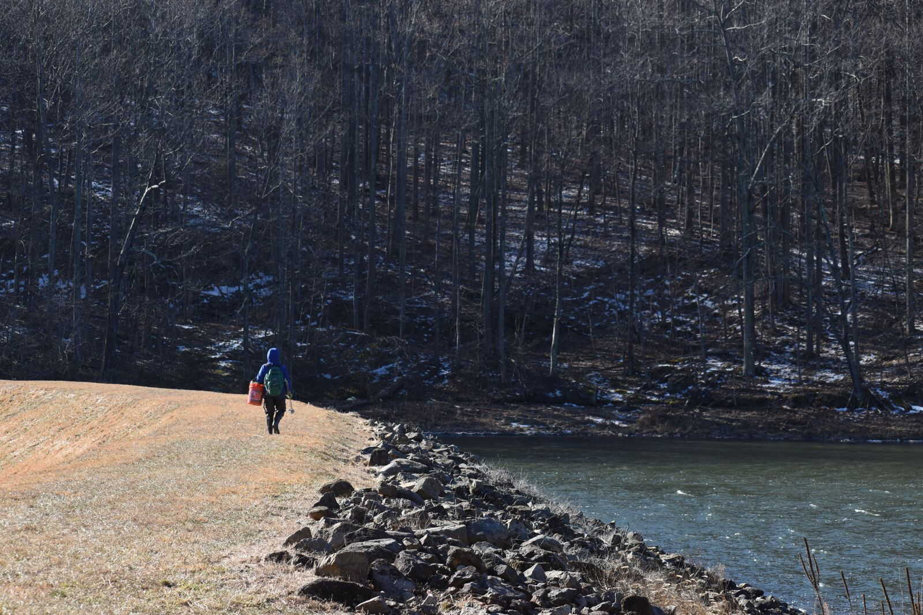
Operation BVR Inflows!

Slide 2
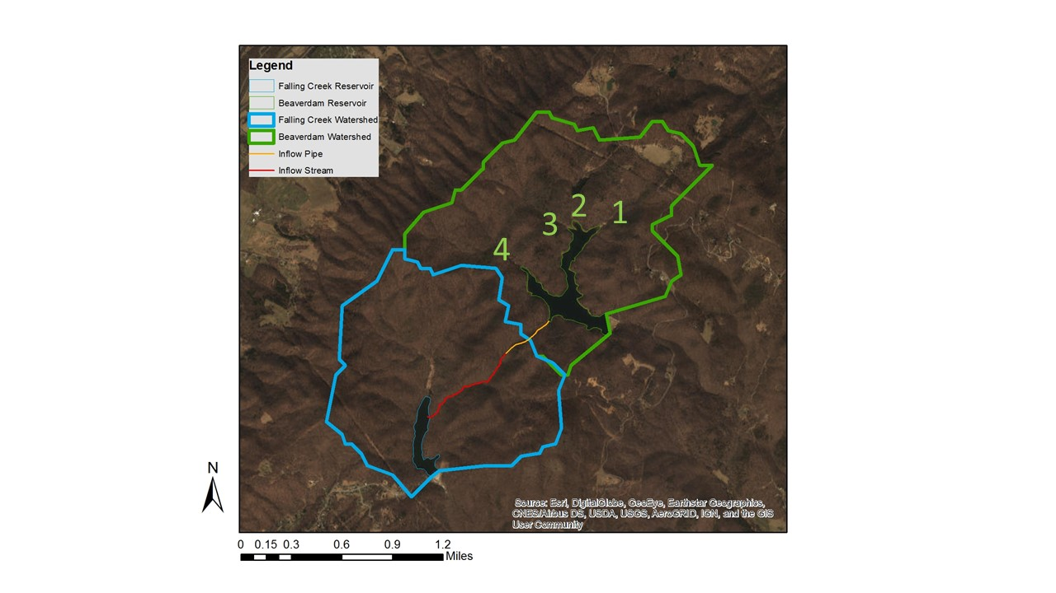
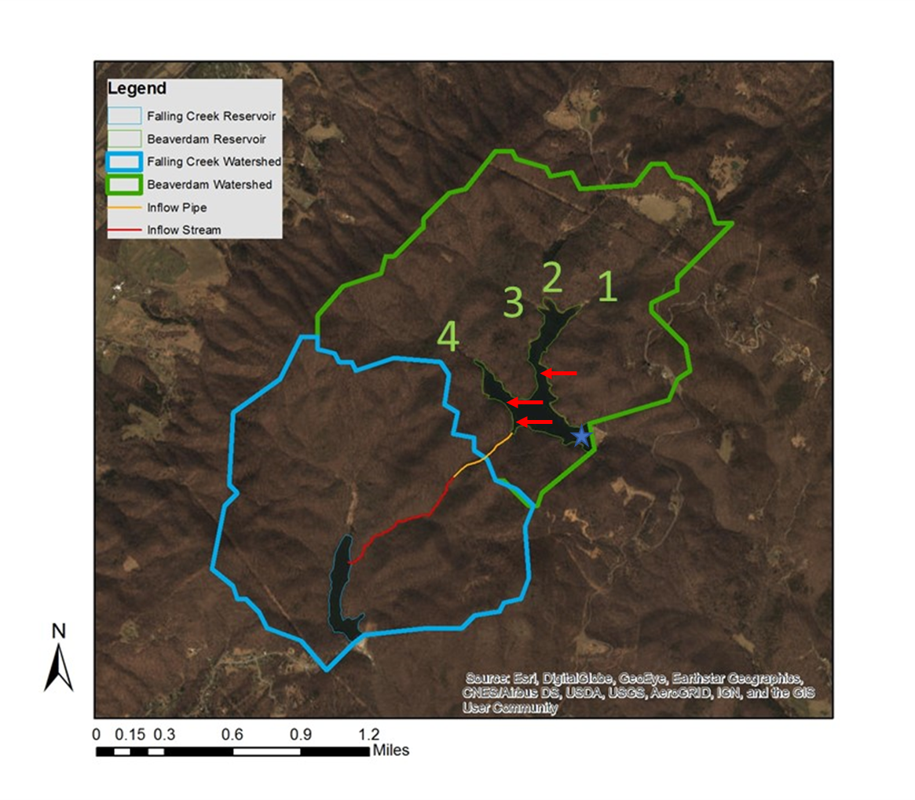

Slide 3
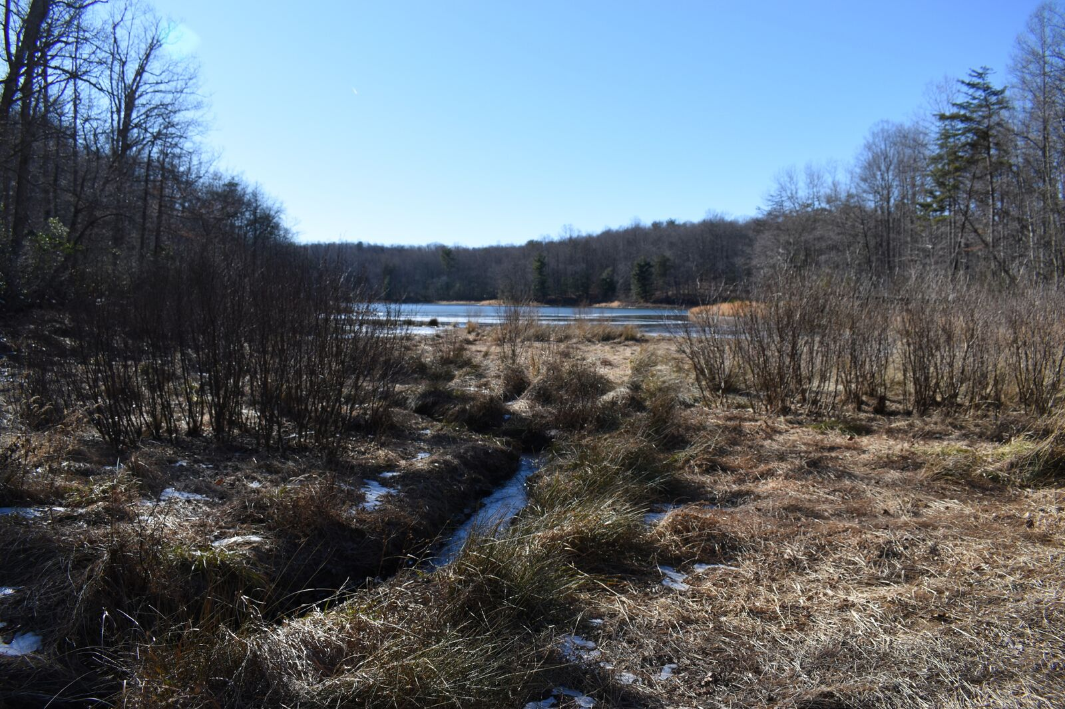
Inflow 1—The Thumb
Stream width: 0.6m
Discharge: 0.021 m³/s
Temp: 3.3C
%DO: 114%
SpCond: 31.8 uS
Highest conductivity
Multiple small ephemeral
streams at this location

Slide 4
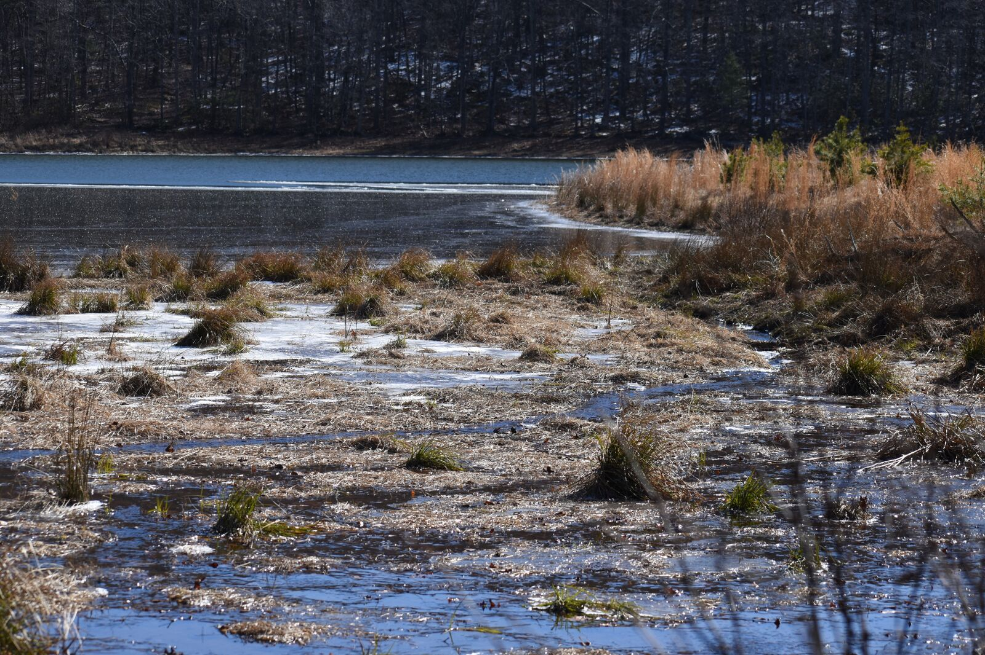
Inflow 2—The Dead Marsh
Stream width: 0.85m
Discharge: 0.026 m³/s
Highest discharge
Evidence of high flow
Temp: 2.8C
%DO: 115%
SpCond: 25.2 uS
Lowest conductivity

Slide 5
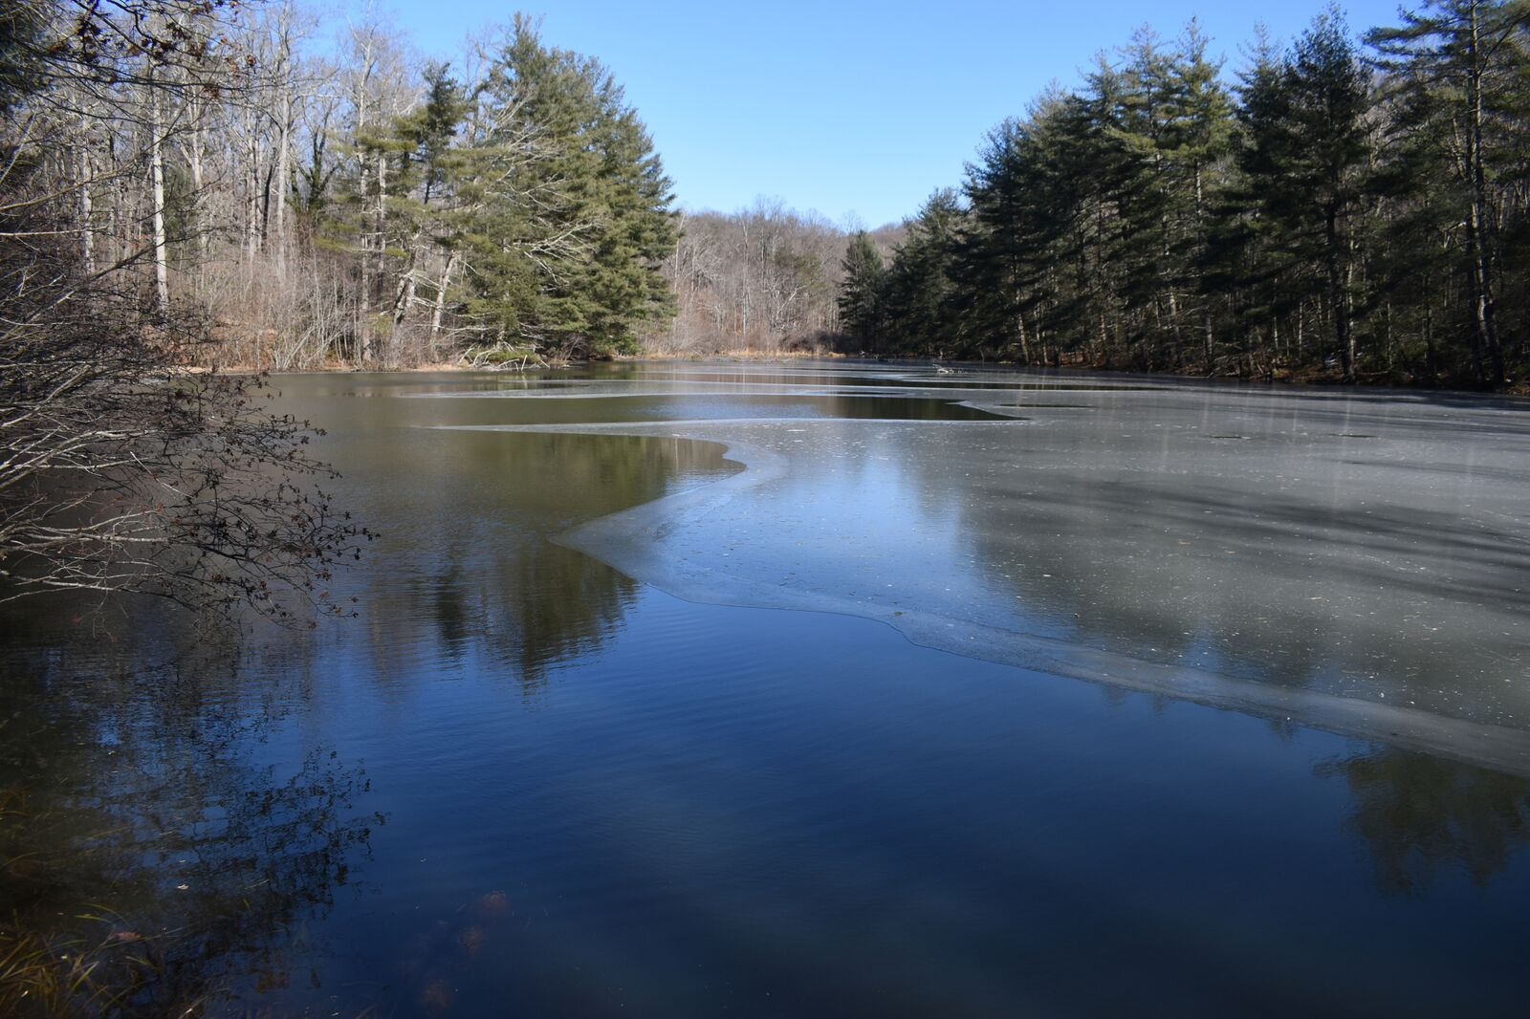
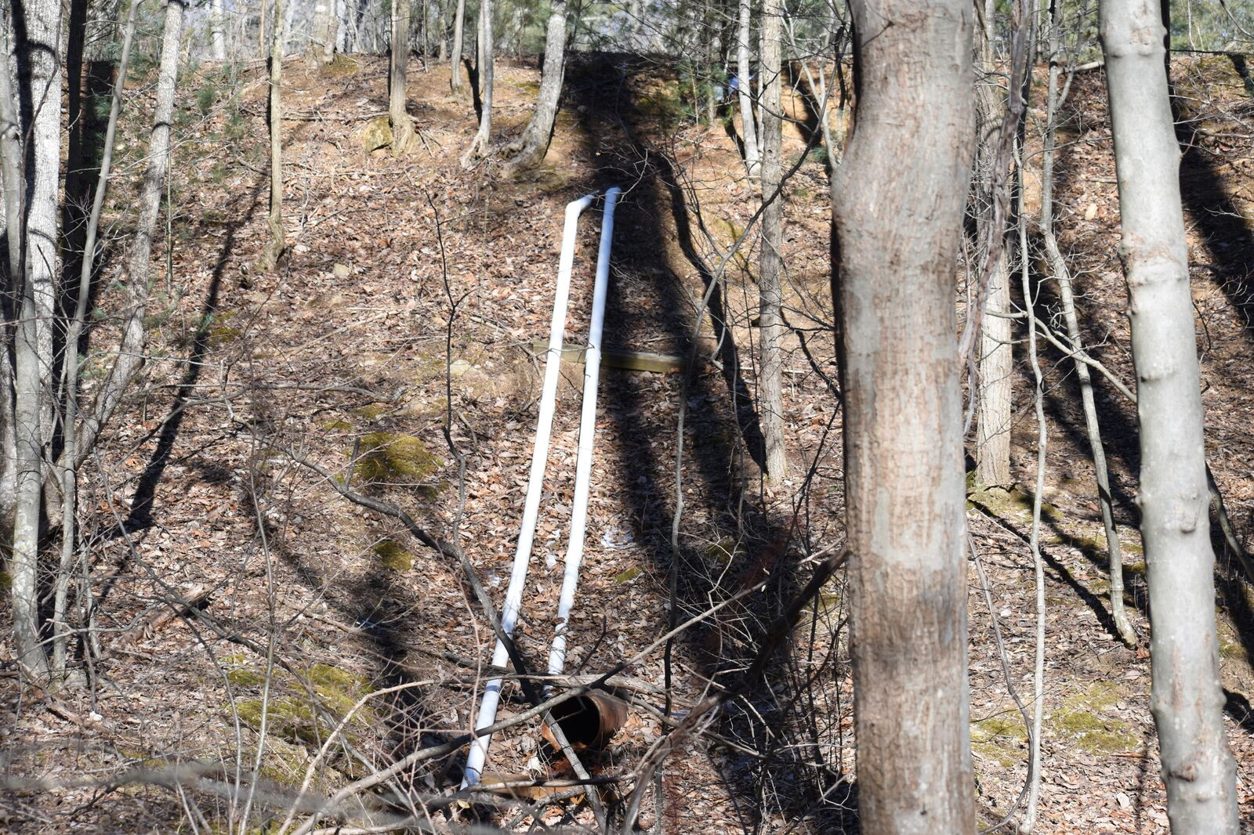
Inflow 2—The Dead Marsh/The Runt

Slide 6
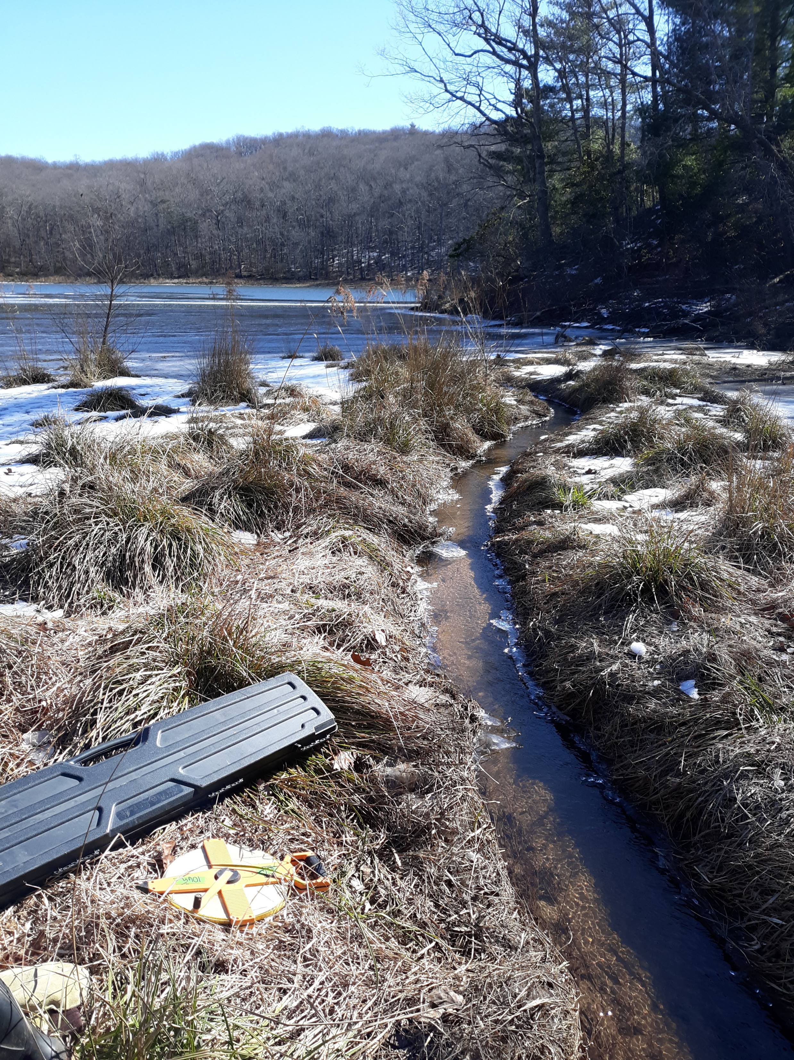
Inflow 3—Fingerling
Stream width: 0.6m
Discharge: 0.016 m³/s
Lowest discharge
Temp: 1.4C
Lowest temp
%DO: 112.5%
SpCond: 29.5 uS

Slide 7
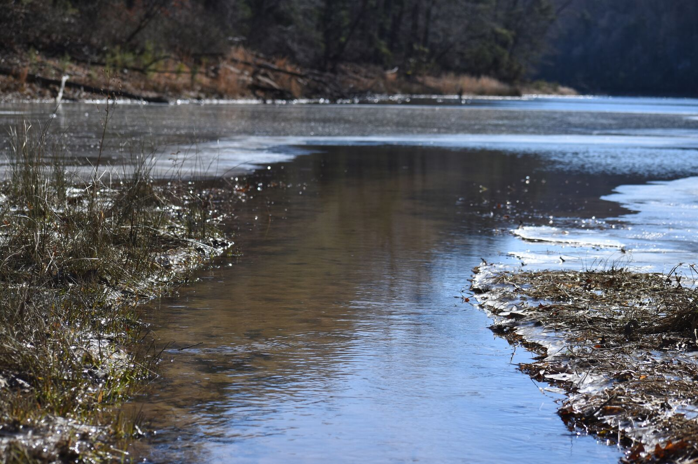
Inflow 4—Lone Ranger
Stream width: 1.1m
Widest stream
Discharge: 0.024 m³/s
2nd highest discharge
Temp: 3.4C
%DO: 114%
SpCond: 28.8 uS

Slide 8
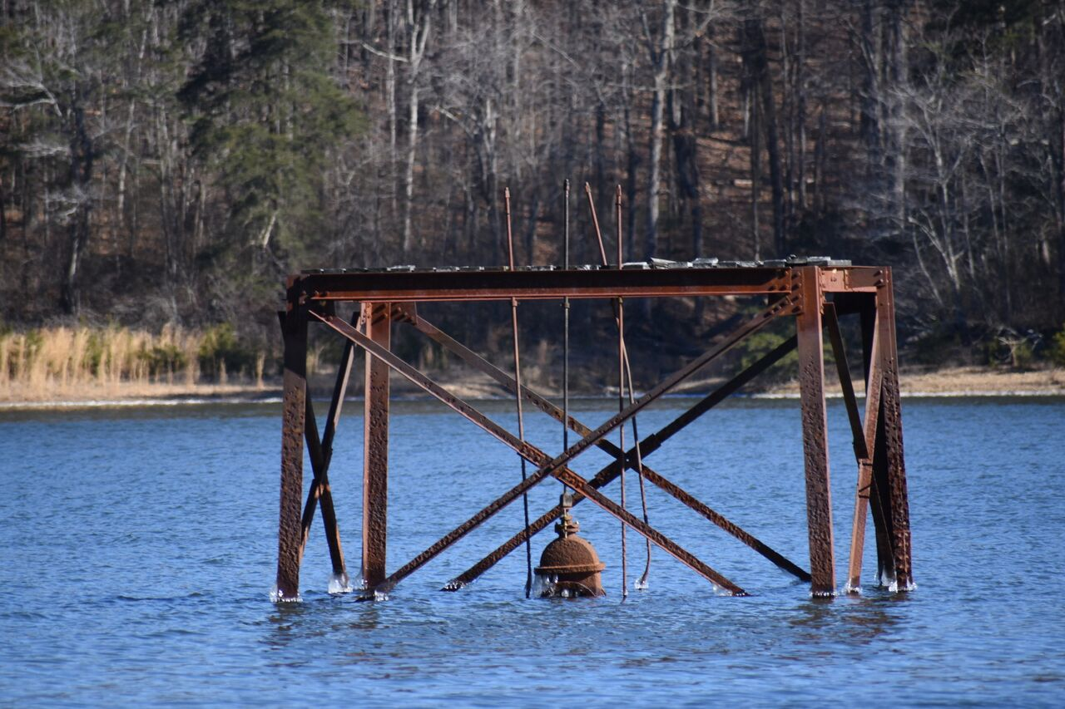
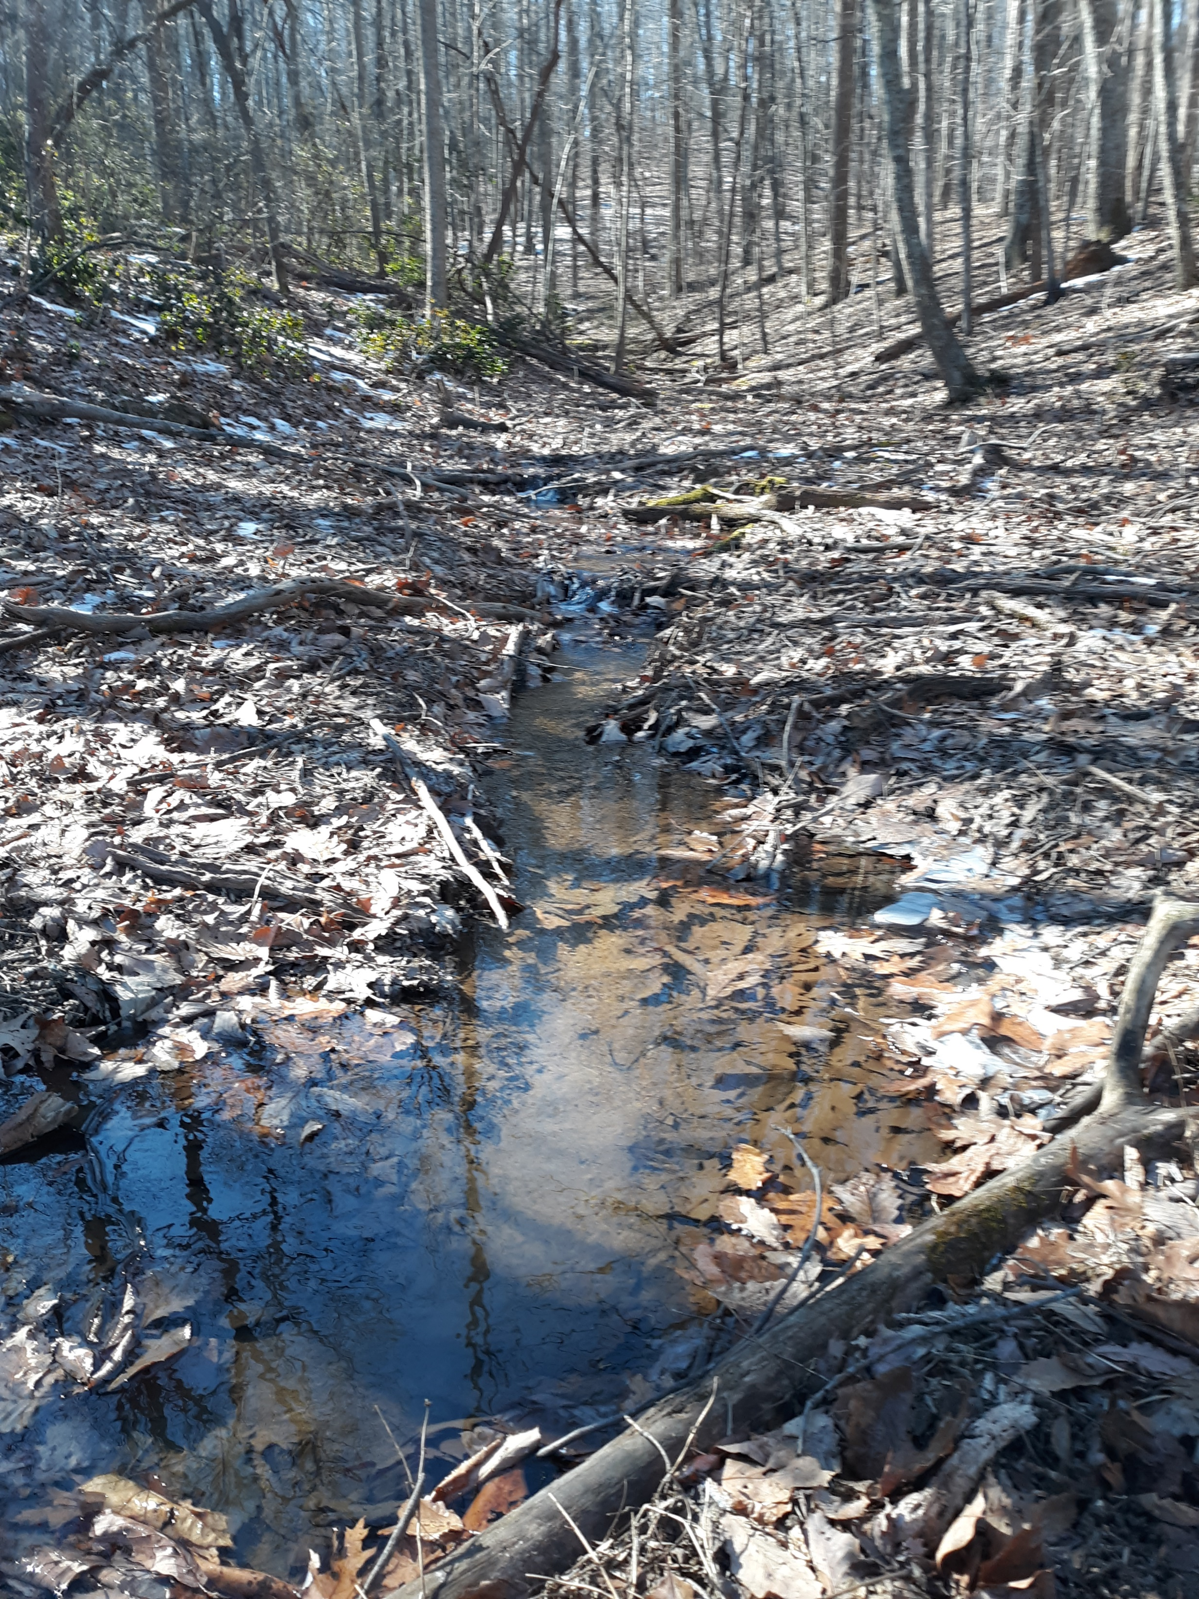
Inflow-Outflow at the 2nd platform

Slide 9
Next steps
Nutrient analysis of grab samples
GIS calculations
Shed some light on relative importance of other inflows
Does not capture groundwater inputs
Capture discharge as the seasons change
Evidence of ephemeral streams and much higher flow
Prioritize inflows and plan summer sampling regime
High flow events are probably really important
Regular monitoring-how regular…?
Thoughts?????

